Slide 1
Amazon Web Service
Presented By : Medhavi College

Slide 2
Introduction
Secure cloud service platform
Offers compute power (resources), database storage through network/internet
Flexibility - language, OS, instance
Cost Effective
Scalability - Use server based on requirements
Security

Slide 3
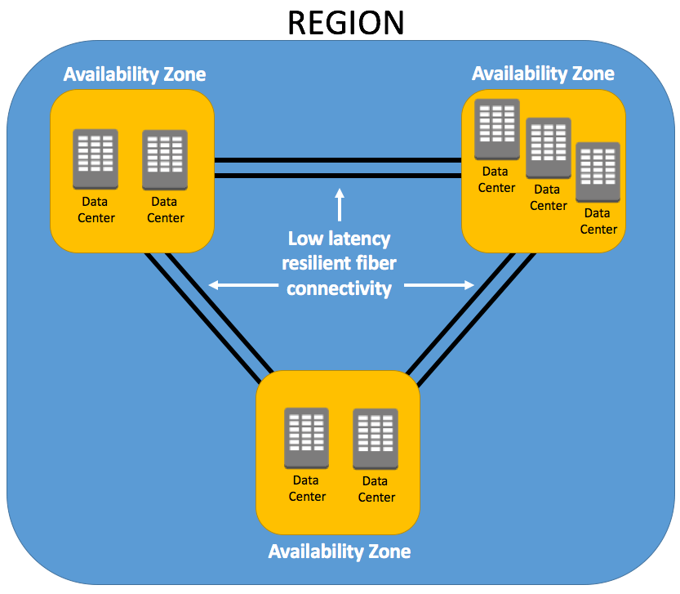
Global Infrastructure

Slide 4
AWS Global Infrastructure
AWS Region - physical location around the world with one or more data center
Connected via AWS backbone network
Regions has a name and code
Mumbai -> ap-south-1
Sydney -> ap-southeast-2
25 Launched Regions

Slide 5
Why many regions ?
lower latency access to application
Fault tolerance
Stability

Slide 6
Availability Zones (AZ)
Particular location within a AWS region
Every region consists of 2 or more cluster of data centers called Availability zone
A data center or cluster of data center which are at one place
Two data centers are isolated baked on electricity, air condition
Data transfer is done in private network and fast
1 Region = Multiple AZs (Min 3)
1 AZ = cluster of data centre
Located at 50-100km
81 Availability Zones

Slide 7
Why multiple AZs
Application high availability
servers and databases can be launched across AZs
Synchronous replication is possible
( with latency < 10ms)
Fault tolerance
if one goes down another works

Slide 8
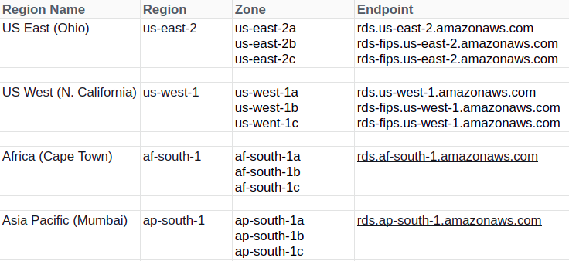
Stats

Slide 9
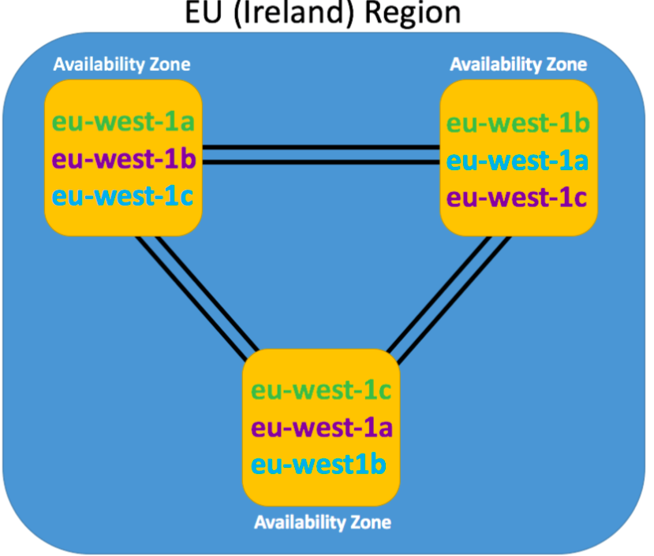
Region/Zone

